Slide 1
Lecture 9: Key Distribution
An Introduction to Information Security
School of Big Data and Software Engineering, CQU
Fall, 2018

Slide 2
Quickly Review
Lecture 8
Stream Cipher
Produce random key stream,
xor plaintext / ciphertext
RC4: byte oriented stream cipher
initialization
initial permutation, and
stream generation
encryption/decryption: xor

Slide 3

Outline
Lecture 9. Key Distribution
Lecture 10. Key Exchange

Slide 4




Lecture 9: Key Management
1. Key Distribution
1.1 Key Distribution: Roles
In symmetric key cryptography, both parties must possess a secret key which they must exchange prior to using any encryption.
symmetric-key cipher：en/decryption with the same key
Alice
Bob
Plaintext
Plaintext
Encryption Algorithm
Secure Key-exchange Channel
Decryption Algorithm
Shared Secret-Key
Shared Secret-Key
Ciphertext
Ciphertext
Insecure Channel

Slide 5

Lecture 9: Key Management
1. Key Distribution
1.2 Key Distribution: Definition
Deliver a key to two parties who wish to exchange encrypted data, without allowing others to see the key.
Secure Key-exchange Channel
Alice
Shared Secret-Key
Shared Secret-Key
Bob

Slide 6

Lecture 9: Key Management
1. Key Distribution
1.3 Key Distribution: History
第二次世界大战中德军U型潜艇油画

Slide 7

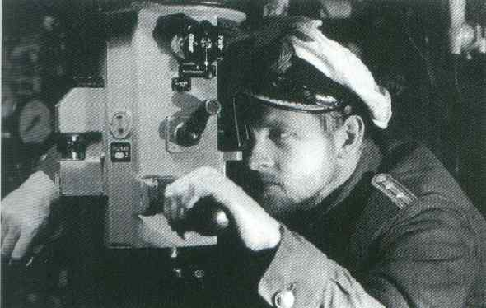
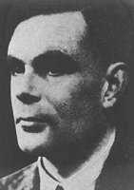
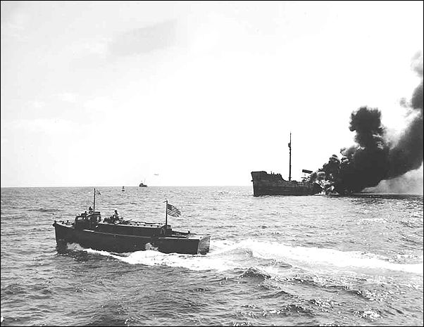
Lecture 9: Key Management
1. Key Distribution
1.3 Key Distribution: History
During the Second World War the German High Command had to distribute the monthly book of day keys to all its Enigma operators.
Also, U-boats, which tended to spend extended periods away from base, had to somehow obtain a regular supply of keys.
图灵

Slide 8

Lecture 9: Key Management
1. Key Distribution
1.3 Key Distribution: History
The U.S. government keys are managed and distributed by COMSEC.
In the 1970s, COMSEC was responsible for transporting tons of keys every day.
When ships carrying COMSEC material came into dock, crypto-custodians(密码管理机构) would march onboard, collect stacks of cards, paper tapes, floppy disks, and then deliver them to the intended recipients.
…

Slide 9
Lecture 9: Key Management
1. Key Distribution
1.3 Key Distribution: Models
i) A key can be selected by A and physically delivered to B
physical Channel
Alice
Shared Secret-Key
Shared Secret-Key
Bob
What is Physical channel？

Slide 10
Lecture 9: Key Management
1. Key Distribution
1.3 Key Distribution: Models
ii) A trusted third party can select the key and physically delivered it to A and B
Carl
physical Channel
physical Channel
Alice
Shared Secret-Key
Shared Secret-Key
Bob

Slide 11


Lecture 9: Key Management
1. Key Distribution
1.3 Key Distribution: Models
iii) If A and B have previously and recently used a key, one party can transmit the new key to the other, encrypted using the old key.
secure Channel
Alice
New Key
Shared New Key
Bob
Old Key
Old Key

Slide 12
Lecture 9: Key Management
1. Key Distribution
1.3 Key Distribution: Models
iv) If A and B each has an encrypted connection to a third party C, C can deliver a key on the encrypted links to A and B
Carl
secure Channel
secure Channel
Alice
Bob

Slide 13
Lecture 9: Key Management
1. Key Distribution
1.4 Key Distribution Model: Assessment
Option 1 and 2 are “reasonable” for link encryption.
Why?
Because each link encryption device exchanges data only with its partner on the other end of the link.
工程思想
The weight of jobs of delivering keys is light.
But, for End-to-End Encryption?

Slide 14
Lecture 9: Key Management
1. Key Distribution
1.4 Key Distribution Model: Assessment
At network
or IP layer
Suppose there are N nodes, then the number of required keys is:
For example, 1000 nodes, 10,000 applications, we should have
At application
layer
人工传递，
不要命啦？
50,000,000 keys!

Slide 15
Lecture 9: Key Management
1. Key Distribution
1.5 Key Distribution Model: Assessment
iii) use old key
What’s your comment about option 3?
It can be used in both link-encryption and end-to-end encryption
But what will happen if an opponent gain one old key?
How to distribute the initial possible millions of keys?

Slide 16
Lecture 9: Key Management
1. Key Distribution
1.5 Key Distribution Model: Assessment
iv) the third party encryption
In this case, a Key Distribution Center (KDC) is responsible(负责) for distributing keys to pairs of users as needed.
KDC
Secure Channel
A
C
B

Slide 17
Lecture 9: Key Management
1. Key Distribution
1.6 Key Distribution Center
The use of a KDC is based on the use of a hierarchy(等级,分层) of keys.
At least two levels of keys are used:
Where to get it?
Session key
A session key is used for the duration of a logical connection, such as TCP, and then discarded when the connection is disconnected.
Master key
The session keys are transmitted in encrypted form, using a Master Key that is shared by the KDC and an end user.
For each end user, there is a unique master key that is shared with KDC, and the master key must be delivered in some fashion.

Slide 18
Lecture 9: Key Management
1. Key Distribution
1.7 Key Distribution Scenario(场景)
Many key distribution scenarios have been proposed, and in the following, we introduce one of the typical scenario, in which we assume that:
Each user shares a unique master key with the KDC.
KDC
Ka
Kb
Kb
Ka
Kc
A
C
Kb
B

Slide 19
Lecture 9: Key Management
1. Key Distribution
Secret channel
1.7 Key Distribution Scenario: preconditions(前提)
Secret channel
KDC
A
B
Alice
Bob
A wishes to establish a logical connection with B
A requires a session key from KDC to protect the communication
A share a master key with KDC, B share with KDC

Slide 20
Lecture 9: Key Management
1. Key Distribution
Key Distribution Scenario: Step 1
KDC
10010000
A
A issues(发出) a request to the KDC for a session key
The request includes who it is (IDA) and whom it wants to talk to (IDB), and
A unique identifier(标识符) N1, which is generated randomly

Slide 21
Lecture 9: Key Management
1. Key Distribution
Key Distribution Scenario: Step 2
Remark: Why?
Authentication of A
KDC
A
The KDC responds A with a message encrypted using
The message includes:
the one-time available session key
To A
the original request, including, N1
the session key
To B
A’s identifier ID_{A}

Slide 22
Lecture 9: Key Management
1. Key Distribution
Key Distribution Scenario: Step 3
A
B
A stores the session key for communicating with B
A“blindly” forwards B the message
B now knows the session key , the IDA, and also knows the message is originated from(源于) KDC
Why?
A and B now are ready to communicate, but…

Slide 23
Lecture 9: Key Management
1. Key Distribution
Key Distribution Scenario: Step 4 and 5
A
B
Using the newly minted session key for encryption, B sends a newly random number N₂ to A
Using , A responds with f(N₂), where f is a function that performs some transformation on N₂
Why?
Which steps are key distribution?
Key distribution procedure involves only step 1 through 3
Step 4 to 5 perform an authentication function

Slide 24

Lecture 9: Key Management
1. Key Distribution
Hierarchical(分等级的) Key Control
For very large networks, a hierarchy of KDCs can be established.
Global
KDC
Local KDC
Local KDC

Slide 25
Lecture 9: Key Management
1. Key Distribution
Session Key Lifetime
The more frequently session keys are exchanged,
the more secure they are.
Any disadvantage?
The distribution of session keys delays the start of any
exchange and places a burden on network capacity
For connection oriented protocols( HTTP,TCP…): ???
For connectionless protocols( UDP,IP):???

Slide 26
Lecture 9: Key Management
1. Key Distribution
Controlling Key Usage
Data-encrypting
for general communication across a network
PIN-encrypting key
for personal identification numbers used in e-commerce.
File-encrypting key
for encrypting files stored in publicly accessible locations

Slide 27
Lecture 9: Key Management
1. Key Distribution
What’s your comment about KDC?
Before two people can exchange a secret they must already share a secret
A great number of session keys should be distributed through the Internet
How can we solve this problem?
历史即将翻开新的一页！

Slide 28
Lecture 9: Key Management
Summary
Key Distribution
KDC
Secure Channel
A
C
B

Slide 29
An Introduction to Information Security
Thanks for your attention!
Q&A

